Slide 1

Use Inheritance and Polymorphism as a Mechanism for Reusability
Course: 420-310-DW Programming III
Instructor: Zahra Habibi
2024-11-11
Notes:
Hello everyone! Welcome to week 5 of our Java Programming course. Today’s topic is … We’re building on what you’ve learned so far (to unlock more powerful ways to write and improve your code. Don’t worry if it feels challenging . That’s how you grow as de’velopers!)
Let’s dive in!

Slide 2
Agenda
Inheritance:
“Object” class as root class in all Java classes
Inheritance examples & overriding the toString() method
When and when not to use inheritance.
Polymorphism:
Compile-time and run-time polymorphism.
When and when not to use run-time polymorphism.
Constructor Chaining
Summary:
Case Study: Duck Hunt Simulation Game
Various challenges when attempting to avoid code duplication
Possible solutions with inheritance and polymorphism
Notes:
Here’s our plan today. First, we’ll do a quick review of procedural and object-oriented programming.
Then, we’ll get into inheritance—looking at examples and when it’s appropriate to use it or avoid it.
Next, we’ll discuss polymorphism and its two types: static and dynamic polymorphism, along with examples of when to use them.
Finally, we’ll wrap up by connecting these concepts to real-world programming and discuss the limitations of simple solutions as they scale to larger code bases."

Slide 3
Inheritance
Notes:
Good afternoon,
Thank you for joining this meeting.
I’m going to present my master’s thesis entitled

Slide 4
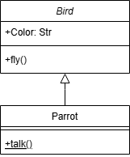
Inheritance:
One of the most important concepts in object-oriented programming.
Inheritance allows us to define a class in terms of another class, which makes it easier to create, organize, and maintain an application.
Inheritance provides the opportunity to reuse code functionality and accelerate implementation time (less time to code, test, and so on).
When creating a new class, a programmer can simplify development by inheriting member variables and methods from an existing class, rather than writing them from scratch.
Existing class is called the base class or superclass, and the new class is referred to as the derived class or a subclass.
Notes:
As the slide shows, a parrot is a type of bird. Through inheritance, the Parrot class can access the attributes and methods of the Bird class, like fly(), and add new ones, like talk(), without duplicating code.

Slide 5
Inheritance: Object Class
The Object class is the root class of the Java class hierarchy.
It’s part of the java.lang package, which is automatically imported into every Java program.
This class provides several fundamental methods, like equals(), toString().
Implicit Inheritance Mechanism: When you create a new class in Java, if you don’t specify an explicit superclass using extends, Java automatically makes your class extend Object class.
public class MyClass {
// class code
}
public class MyClass extends Object {
// class code
}

Slide 6
Inheritance: Overriding toString()
toString() method is defined in the Object class, and by default returns a string that includes the class name followed by the "@" symbol and memory address.
Often overridden to provide a meaningful description of an object’s state. Simply put, it returns a string representation of an object.
public class Person {
private String name;
private int age;
public Person(String name, int age) {
this.name = name;
this.age = age;
}
@Override
public String toString() {
return "Person {name=' "+ name +" ', age=" + age + "}";
}
}
public class Main {
public static void main(String[] args) {
Person person = new Person("Alice", 30);
System.out.println(person);
}
}
// Output: Person {name='Alice', age=30}
Notes:
This example shows how overriding toString() can create a readable, customized representation of an object. This code demonstrates a Person class with a customized toString() method to format the object’s output.
Person Class:
Attributes: name (String) and age (int) represent a person’s name and age.
Constructor: Initializes name and age when a Person object is created.
toString() Method: Overrides the default toString() method to return a formatted string, displaying name and age in the forma…
Main Class:
Creates a Person object named person with name set to "Alice" and age set to 30.
Calls System.out.println(person);, which automatically uses the toString() method of the Person class to print the output: "Person {name='Alice', age=30}".

Slide 7
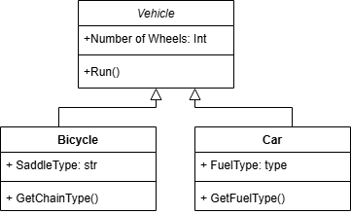
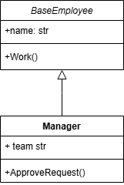
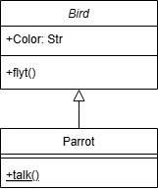
Inheritance: when to use?
Inheritance allows us to define a class in terms of another class.
We can use inheritance for:
“Is-A” Relationship: a Parrot is a Bird, so it could inherit from the base Bird class.
Code usability: Car and Bike classes have similar methods and attributes, we can extract common code to a Vehicle superclass.
Extending behavior: Manager extends BaseEmployee while includes additional permissions or responsibilities.
Extend Behavior
Is-A Relationship
Code Usability
Notes:
So far we know that …. And it’s time to ask the question when to use it?
When we have a clear relationship between the base and subclass.

Slide 8
Inheritance: when not to use?
Avoid inheritance with tightly coupled classes, because making change to superclass, leads to change to subclasses, which is not efficient for code maintenance.
Entity
A new method in Entity class, would be visible in all child classes (code pollution)
Inheritance is usually good to one or two levels!
Solution?
User
Course
password
Instructor
Student
password
Remove User Class & move codes to subclasses (code duplication).
isFullTime
Remove Part-time & full-time instructor subclasses and use a boolean flag in parent Instructor class .
Part-time Instructor
Full-time Instructor
Notes:
Logically the next question is when to avoid it?

Slide 9
Polymorphism
Notes:
Good afternoon,
Thank you for joining this meeting.
I’m going to present my master’s thesis entitled

Slide 10
Polymorphism:
Polymorphism means “many forms”.
It allows methods or objects to behave in multiple ways by enabling a single action to operate differently.
Polymorphism
Compile-time (early binding or static) polymorphism
occurs when multiple methods in the same class have
the same name but differ in their parameter types or
numbers.
Compile Time
Run Time
Run-time (late binding or dynamic) polymorphism
occurs when a subclass provides a specific implementation of a method that is already defined
in its superclass.
Method Overloading
Method Overriding
Interface
Abstract
Notes:
Good afternoon,
Thank you for joining this meeting.
I’m going to present my master’s thesis entitled

Slide 11
Polymorphism: Example 1 - Overloading
The add() method in the same class is overloaded with different parameter lists, allowing the same method name to be used for different actions.
The return type of a function has no effect on function overloading.
public class Main {
public static void main(String[] args) {
Calculator calc = new Calculator();
// Calls add(int, int)
System.out.println (calc.add(5, 10));
// Calls add(int, int, int)
System.out.println (calc.add(5, 10, 15));
}
}
class Calculator {
// Method to add two integers
int add (int a, int b) {
return a + b;
}
// Method to add three integers
int add (int a, int b, int c) {
return a + b + c;
}
}
Notes:
Let have a look at an example for overriding:
This shows how method overloading allows the same method name (add) to handle different numbers of arguments, providing flexibility and readability.
This code demonstrates method overloading in Java, where the Calculator class has multiple add() methods with different parameter lists.
Calculator Class:
add(int a, int b): Adds two integers and returns the result.
add(int a, int b, int c): Adds three integers and returns the result.
Both methods are named add but differ in the number of parameters, which is a valid example of method overloading in Java.
Main Class:
Creates an instance of Calculator named calc.
Calls calc.add(5, 10), which matches add(int, int) and outputs 15.
Calls calc.add(5, 10, 15), which matches add(int, int, int) and outputs 30.

Slide 12
Polymorphism: Example 2 - Overriding
It involves with inheritance.
When myDog.sound() is called, Java dynamically determines the Dog class's sound method at runtime.
// base class
class Animal {
void sound() {
System.out.println ("Animal makes a sound");
}
}
public class Main {
public static void main(String[] args) {
// Animal reference but Dog object
Animal myDog = new Dog();
// Calls Dog's overridden sound method
myDog.sound();
}
}
// subclass
class Dog extends Animal {
@Override
void sound() {
System.out.println ("Dog barks");
}
}
Notes:
The next example is about overriding which …
This code demonstrates method overriding and polymorphism in Java, where a subclass provides a specific implementation of a method defined in the base class.
Animal Class (Base Class):
Contains a sound() method that outputs "Animal makes a sound".
The sound() method is intended to be overridden by subclasses to specify different sounds for different animals.
Dog Class (Subclass):
Inherits from Animal and overrides the sound() method.
The overridden sound() method outputs "Dog barks" to represent the sound a dog makes.
Main Class (Main Method):
Creates an Animal reference, myDog, that points to a Dog object (new Dog()).
Calling myDog.sound() uses runtime polymorphism to determine the actual type of myDog at runtime, which is Dog.
As a result, the sound() method in Dog is called, and "Dog barks" is printed.
This approach highlights polymorphism, where an Animal reference can call the correct sound() method based on the actual object type at runtime, not the reference type.

Slide 13
When and When not to Use Run-Time Polymorphism
Dynamic polymorphism has slower execution compare to static polymorphism.
However, dynamic polymorphism provides flexibility:
Work with objects without needing to know their specific class in advance.
Eliminating if-else or switch statements.
class Character {
// better to use abstract class
void attack() {
System.out.println ("Character
performs a generic attack.");
}
}
public class Game {
public static void main (String[] args) {
Character[] characters = new
Character[w];
characters[0] = new Warrior();
characters[1] = new Archer();
for (Character character : characters) {
// Runtime polymorphism to
// determine the type of object
character.attack();
}
}
}
class Archer extends Character {
@Override
public void attack() {
System.out.println("Archer
shoots a precise arrow!");
}
}
class Warrior extends Character {
@Override
public void attack() {
System.out.println("Warrior
swings a mighty sword!");
}
}
Notes:
This code illustrates where a base class method is overridden by subclasses to provide specific behavior.
Character Class (Base Class):
Contains an attack() method that outputs a generic attack message.
The code suggests that Character could be an abstract class to avoid instantiation and require subclasses to define specific attacks.
Archer Class:
Inherits from Character and overrides attack() to output "Archer shoots a precise arrow!"
Warrior Class:
Also inherits from Character and overrides attack() to output "Warrior swings a mighty sword!"
Game Class (Main Method):
Creates an array characters of type Character, storing different character types (Warrior and Archer).
Uses a for loop to call attack() on each character in the array.
Due to runtime polymorphism, the correct attack() method is called based on the actual object type (Warrior or Archer), not the Character reference type.
This demonstrates polymorphism, where the attack() method behaves differently depending on the character type, allowing for flexible and dynamic behavior. Note: w should be defined to specify the array size.

Slide 14
Constructor Chaining by Overloading
Constructor Chaining is a technique where one constructor calls another constructor within the same class or from its superclass. Providing multiple options for creating an object.
Within same class by using this( ) keyword for constructors in the same class.
public class Person {
private String name;
private int age;
// Constructor 1: Name, age
public Person (String name, int age) {
this.name = name; this.age = age;
}
// Constructor 2: Only name
public Person (String name) {
this (name, 20); // calls constructor 1
}
@Override
public String toString() {
return name + “, ” + age;
}
}
public class Example {
public static void main (String[] args) {
//calls constructor 1
Person person1 = new Person("Alice", 25);
// calls constructor 2
Person person2 = new Person("Bob");
System.out.println (person1); //outputs: Alice, 25
System.out.println (person2); //outputs: Bob, 20
}
}
Notes:
Now I’d like to explain the Constructor chaining technique
This code defines a Person class with two constructors to initialize objects in different ways, and an Example class to demonstrate its usage.
Person Class:
Attributes: name (String) and age (int) represent the person’s name and age.
Constructor 1: Takes name and age as parameters and sets the corresponding fields.
Constructor 2: Takes only name as a parameter. It uses constructor chaining to call the first constructor with a default age of 30.
toString() Method: Overrides the toString() method to return the name and age in the format "name, age".
Example Class:
Main Method: Creates two Person objects:
person1 is created with the name "Alice" and age 25, using Constructor 1.
person2 is created with the name "Bob" only, using Constructor 2, which defaults the age to 30.
Output:
System.out.println(person1); outputs "Alice, 25".
System.out.println(person2); outputs "Bob, 30".
This design shows how constructor chaining allows for flexible object initialization with default values.

Slide 15
Constructor Chaining To Invoke Superclass Constructor
Constructor Chaining between subclass and superclass using super().
// Base class
class Pet {
private String name;
private int age;
// Constructor for Pet
public Pet (String name, int age) {
this.name = name; this.age = age;
}
public void eat() {
System.out.println (name + " is eating.");
} }
Use super() only for constructor chaining in subclass.
// Main class
public class Main {
public static void main (String[] args) {
Dog dog = new Dog ("Buddy", 5, "Golden");
// Pet constructor called for Dog
dog.eat(); // output: Buddy is eating
}
}
// Subclass
class Dog extends Pet {
private String breed;
// Constructor for Dog
public Dog (String name, int age, String breed) {
super (name, age); // calles Pet constructor
this.breed = breed;}
}
Notes:
This code demonstrates inheritance by defining a Pet base class and a Dog subclass that extends it.
Pet Class (Base Class):
Attributes: name and age, representing the pet’s name and age.
Constructor: Initializes name and age fields when a Pet object is created.
Method eat(): Prints a message indicating that the pet is eating, using the name attribute.
Dog Class (Subclass):
Attribute: breed, representing the dog's breed.
Constructor: Takes name, age, and breed as parameters. It calls the super constructor of Pet to initialize name and age, then sets the breed field.
Main Class:
Main Method: Creates a Dog object named "Buddy", with age 5 and breed "Golden".
Calling dog.eat(): Since Dog inherits the eat() method from Pet, calling dog.eat() outputs "Buddy is eating."
This setup illustrates inheritance, where Dog reuses Pet's attributes and methods, showing how subclasses can extend base class functionality.

Slide 16
Case Study:
Duck Hunt Simulation Game
Notes:
Good afternoon,
Thank you for joining this meeting.
I’m going to present my master’s thesis entitled

Slide 17
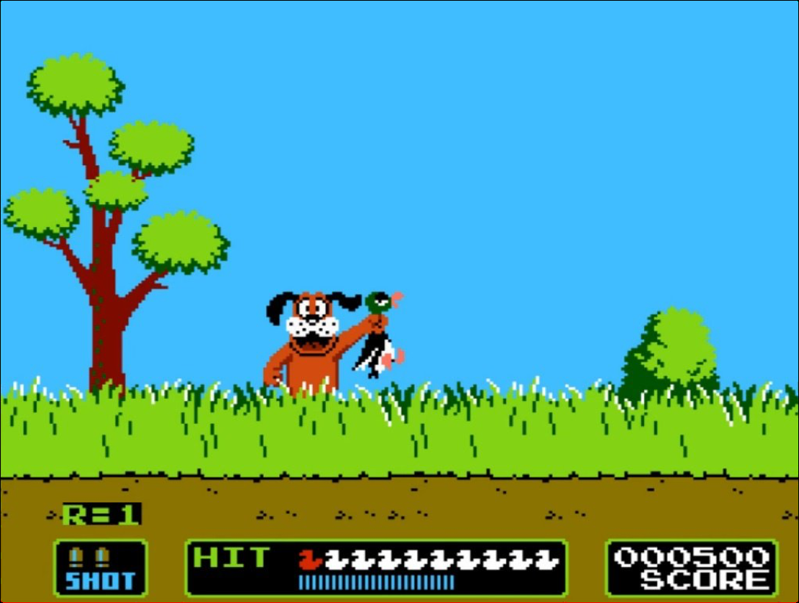
Case Study: Duck Hunt Simulation Game
Suppose a company is building a duck hunt simulation game …
Different options for modelling of object oriented programming for the duck class is suggested.
https://www.everything80spodcast.com/duck-hunt/
Notes:
Good afternoon,
Thank you for joining this meeting.
I’m going to present my master’s thesis entitled

Slide 18
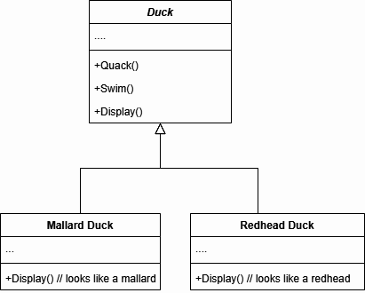
Modeling Duck: Polymorphism
Assume we have 2 classes: RedHead Duck & Mallard Duck.
Both Redhead & Mallard have the same behavior: Quack() & Fly().
We extract common code from the subclasses to superclass “Duck”, and only override the display() method.
Duck() superclass takes care of implementation
of Quack() and Swim() Behaviors. Common
behaviors between all ducks.
Mallard & Redhead duck subclasses takes care
of display() overridden method.
Seems easy solution, right?
Notes:
Good afternoon,
Thank you for joining this meeting.
I’m going to present my master’s thesis entitled

Slide 19
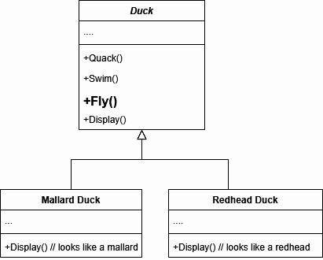
Modeling Duck: New Behavior
After a few month, company decides to add a
new behavior, Fly().
Both Mallard and Redhead ducks fly, so this Fly()
method will be implemented in superclass Duck().
Recall: Classes should be open for extension but
close for modification.
Still seems ok.
Notes:
Open-Closed Principle, a key concept in object-oriented design. It means that a class should allow its behavior to be extended without changing its existing code. You can add new functionality by creating subclasses or using interfaces, but you should avoid altering the original class, as this helps maintain stability and reduce the risk of introducing bugs.

Slide 20
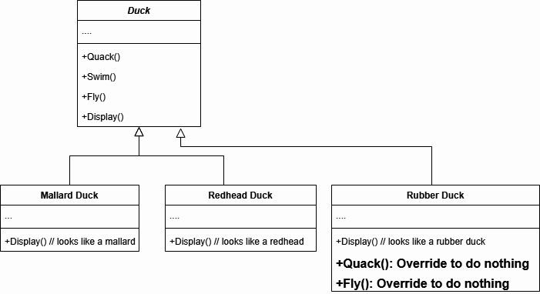

Modeling Duck: Problem
Once again, after a few months, the company decides to add a new duck to the game—a rubber duck.
Problem: Rubber Duck does not have Fly() nor Quack() behavior. But these methods (Fly & Quack) have already been inherited to the Rub duck class!
Solution: Override these behavior in the rubber duck class and do nothing!
Inheritance works well here, but it can get complicated if the company decides to add more classes with different behaviors.
This solution is not scalable!
Notes:
Good afternoon,
Thank you for joining this meeting.
I’m going to present my master’s thesis entitled

Slide 21
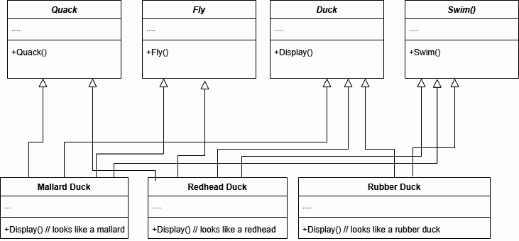
Modeling Duck: Solution 1 - Multiple Inheritance
Other solution is to separate the duck behaviors into distinct classes and apply multiple inheritance for subclasses like Mallard and Redhead ducks.
But, Java does not support multiple inheritance directly through classes. We can use either interface or use “Default Methods” in Interfaces (Java 8+).
Is the problem solved?
Increased complexity and reduced
Readability.
“Diamond” problem, we may
have conflict in which method()
should be inherited.
That’s why Java has limited
multiple inheritance.
Notes:
The diamond problem occurs in object-oriented programming when a class inherits from two classes that both inherit from a common ancestor. This creates ambiguity about which version of the inherited methods or properties should be used, potentially leading to conflicts.

Slide 22
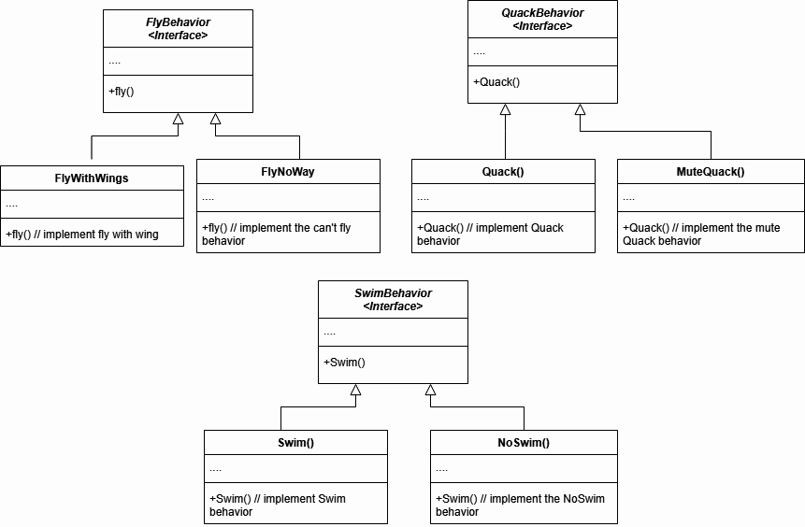
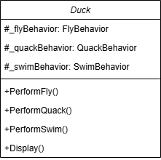
Modeling Duck: Solution 2 - Interface / Abstract Class
Another solution is to encapsulate the duck behaviors through creating abstract classes or interfaces for duck behaviors, Quack(), Fly(), Swim().
We will store fly and quack behaviors as instance variables in the Duck class.
A duck will delegate its flying and quacking behaviours (rather than implementing them itself).
Notes:
Good afternoon,
Thank you for joining this meeting.
I’m going to present my master’s thesis entitled

Slide 23
Modeling Duck: Solution 2 - Interface / Abstract Class
Behavior variables like “_flyBehavior” and “_quackBehavior” are declared as the behavior interface type.
// Fly behavior Interface
interface FlyBehavior {
// Abstract method (does not have a body)
void fly();
}
// Implement the interface
class FlyWithWings implements FlyBehavior {
public void fly() {
System.out.println("flying...");
}
}
// Implement the interface
class FlyNoWay implements FlyBehavior {
public void fly() {
System.out.println("can't fly ...");
}
}
public class Duck {
protected FlyBehavior _flyBehavior;
protected QuackBehavior _quackBehavior;
public Duck() { }
public void performFly() {
_flyBehavior . fly();
}
public void performQuack() {
_quackBehavior.quack();
}
}
Notes:
This code demonstrates a flexible design for a "Duck" class using an interface-based approach to handle different flying behaviors, enabling easy extension.
FlyBehavior Interface: Defines a fly() method that any flying behavior must implement. This allows ducks to have varied flying styles by assigning different implementations of FlyBehavior.
FlyWithWings and FlyNoWay Classes: These are two implementations of the FlyBehavior interface:
FlyWithWings class provides actual flying behavior by implementing fly() with "flying...".
FlyNoWay class represents non-flying behavior, implementing fly() with "can't fly ...".
Duck Class: This is a base class for all ducks, containing a FlyBehavior variable _flyBehavior, which stores the duck’s current flying behavior.
performFly() calls the fly() method of the assigned FlyBehavior, allowing ducks to perform their specific flying behavior.

Slide 24
Modeling Duck: Solution 2 - Interface / Abstract Class
class MallardDuck extends Duck {
MallardDuck () {
this._flyBehavior = new FlyWithWings();
this._quackBehavior = new Quack();
}
}
// Main class
public class Main {
public static void main(String[] args) {
MallardDuck mallardDuck = new MallardDuck();
RubberDuck rubberDuck = new RubberDuck ();
// Perform behaviors
mallardDuck.performFly();
mallardDuck.performQuack();
}
}
class RubberDuck extends Duck {
RubberDuck () {
this._flyBehavior = new FlyNoWay();
this._quackBehavior = new MuteQuack();
}
}
Advantages:
Can easily add / modify duck types and behaviours without necessarily (or heavily)
modifying our duck classes.
Eliminated code duplication.
Notes:
MallardDuck and RubberDuck Classes: These are specific types of ducks that inherit from Duck.
MallardDuck is initialized with FlyWithWings, meaning it can fly.
RubberDuck uses FlyNoWay, so it can't fly.
Main Class: In main(), instances of MallardDuck and RubberDuck are created. Calling performFly() on mallardDuck displays "flying...", showing that MallardDuck can fly, while RubberDuck would display "can't fly ..." if performFly() were called on it.
This design enables adding new duck types and behaviors without modifying existing code, adhering to the Open-Closed Principle.

Slide 25
Next Session
Interface & Abstract classes will be covered in detail.
Notes:
Good afternoon,
Thank you for joining this meeting.
I’m going to present my master’s thesis entitled

Slide 26
Thank you
Notes:
Good afternoon,
Thank you for joining this meeting.
I’m going to present my master’s thesis entitled

